Slide 1
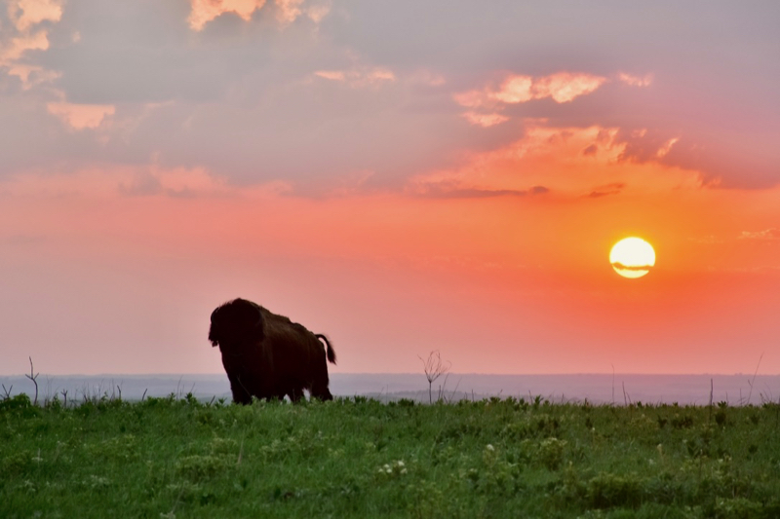
Introduction to Botany

Slide 2
Botanical Implications on the meaning of life, the world, and everything in it

Slide 3
Unlocking the Mysteries of Life with Botany

Slide 4
“Tell me of what plant-birthday a man takes notice, and I shall tell you a good deal about his vocation, his hobbies, his hay fever, and the general level of his ecological education.”
–Aldo Leopold
Notes:
Exercise 1: name a plant, any plant

Slide 5
Today’s Goal:
“The mission of the Kansas Master Naturalist program is to develop knowledgeable and dedicated citizens who are active in promoting awareness, understanding, and stewardship of the natural heritage of Kansas.”

Slide 6
Today’s Goal:
…We can safely assume he knows how plants grow and cats are put together, but let us test his comprehension of how the land is put together.
We are driving down a country road in northern Missouri. Here is a farmstead. Look at the trees in the yard and the soil in the field and tell us whether the original settler carved his farm out of prairie or woods. Did he eat prairie chicken or wild turkey for his Thanksgiving? What plants grew here originally which do not grow here now? Why did they disappear? What did the prairie plants have to do with creating the corn-yielding capacity of this soil? Why does this soil erode now but not then?
Again, suppose we are touring the Ozarks. Here is an abandoned field in which the ragweed is sparse and short. Does this tell us anything about why the mortgage was foreclosed? About how long ago? Would this field be a good place to look for quail? Does short ragweed have any connection with the human story behind yonder graveyard? If all the ragweed in this watershed were short, would that tell us anything about the future of floods in the stream? About the future prospects for bass or trout?
Many students would consider these questions insane, but they are not. Any amateur naturalist with a seeing eye should be able to speculate intelligently on all of them, and have a lot of fun dong it. -Aldo Leopold

Slide 7
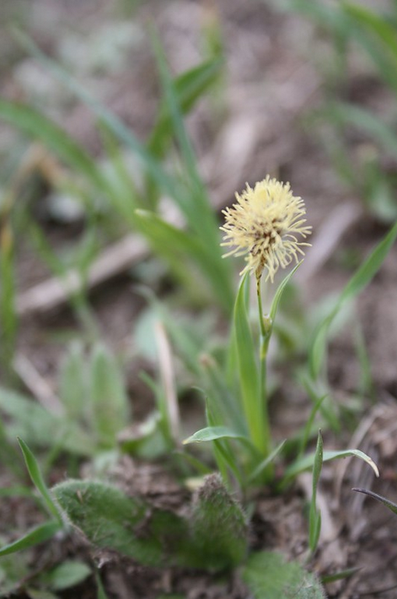
Road Map
Why care?
What are plants?
Systematics & Taxonomy
Plant ecology
Terminology
Application
Konza Prairie
Flora & Communities
Interactive Drivers
Implications
Field Trip
Notes:
In order to understand botany, we have to cover a lot of the basics. The problem is that there are a lot of basics, and the basics are complicated! We may end up lost in the weeds, but I’m a botanist-I get rather enthusiastic about the weeds!

Slide 8
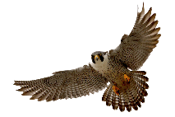
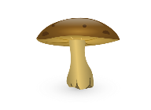
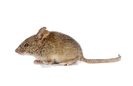
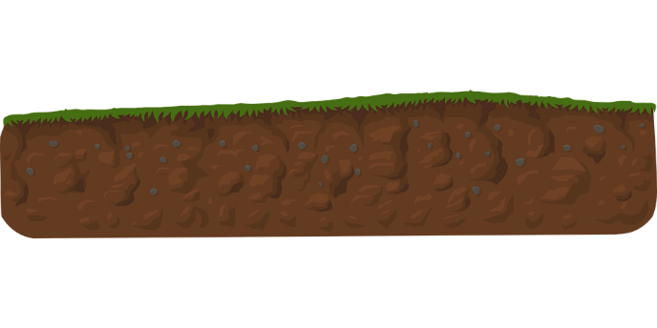
Why care?
Energy lost as heat
Apex Predators
Plants are the base of most ecosystems
Tertiary Consumers
Decomposers
Secondary Consumers
Primary Consumers
Solar Energy
Primary Producers
Recycled Nutrients
Notes:
As scientifically educated people:
Both the material and energy that comprises the living world is captured by plants

Slide 9
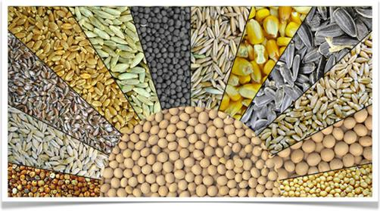
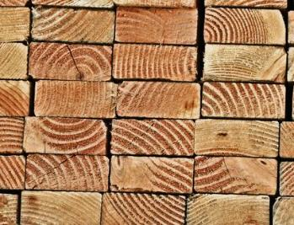
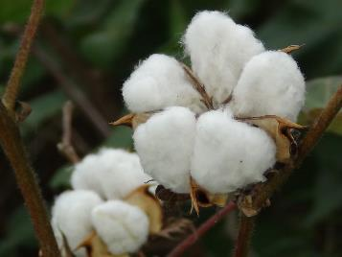
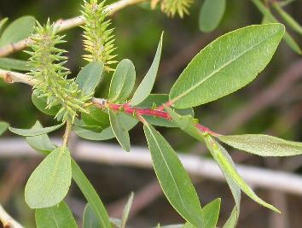
Why care?
Our lives are built with plants
Notes:
As human beings:

Slide 10
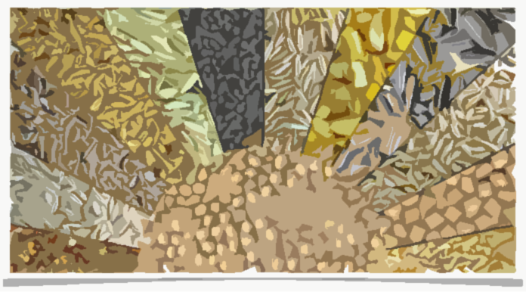
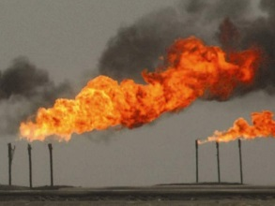
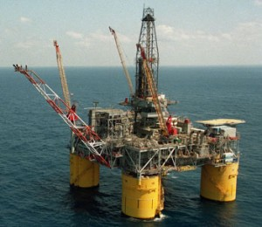
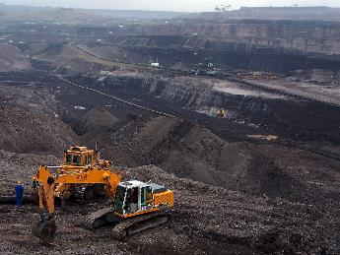
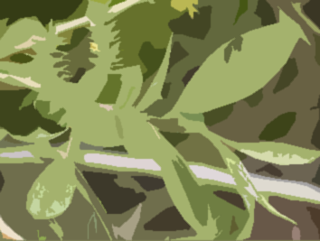
Why care?
Our lives are built with plants

Slide 11
Why care?
Our lives are built with plants
Foundation of human culture

Slide 12
Why care?
Plants are interesting and fun!
Outdoors we are confronted everywhere with wonders; we see that the miraculous is not extraordinary, but the common mode of existence. It is our daily bread.
–Wendell Berry
Notes:
Parasitic plants

Slide 13
Why care?
Plants are interesting and fun!
Outdoors we are confronted everywhere with wonders; we see that the miraculous is not extraordinary, but the common mode of existence. It is our daily bread.
–Wendell Berry
Notes:
Resurrection plants

Slide 14
Why care?
Plants are interesting and fun!
Outdoors we are confronted everywhere with wonders; we see that the miraculous is not extraordinary, but the common mode of existence. It is our daily bread.
–Wendell Berry
Notes:
Plants that eat animals

Slide 15
Why care?
Plants are interesting and fun!
Outdoors we are confronted everywhere with wonders; we see that the miraculous is not extraordinary, but the common mode of existence. It is our daily bread.
–Wendell Berry
Notes:
Toilet plants

Slide 16
Why care?
Plants are interesting and fun!
Outdoors we are confronted everywhere with wonders; we see that the miraculous is not extraordinary, but the common mode of existence. It is our daily bread.
–Wendell Berry
Notes:
mimicry

Slide 17
Why care?
Plants are interesting and fun!
Outdoors we are confronted everywhere with wonders; we see that the miraculous is not extraordinary, but the common mode of existence. It is our daily bread.
–Wendell Berry
Notes:
Among the largest living things

Slide 18
Why care?
Plants are interesting and fun!
Outdoors we are confronted everywhere with wonders; we see that the miraculous is not extraordinary, but the common mode of existence. It is our daily bread.
–Wendell Berry
Notes:
Among the oldest living things- bristlecone pine, Lomatia tasmanica

Slide 19
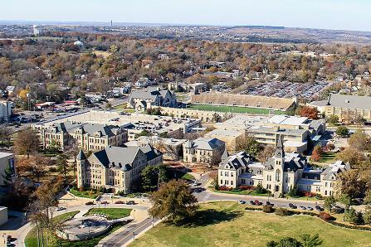
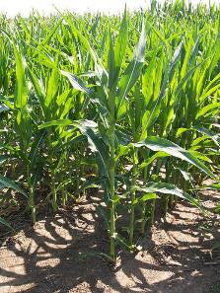
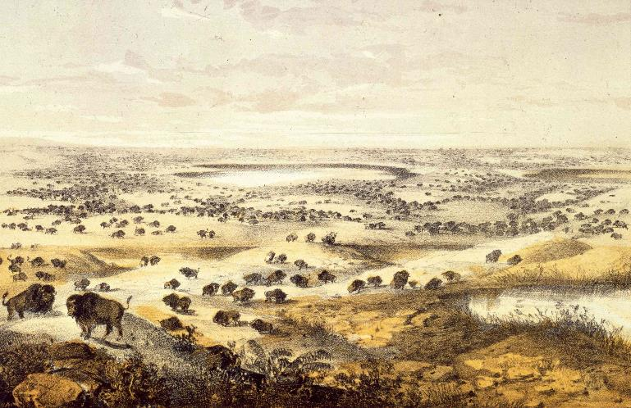
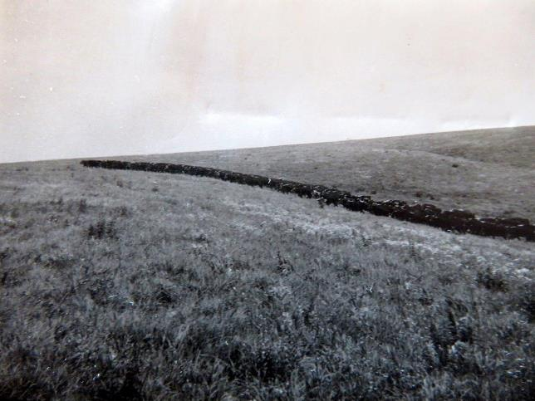
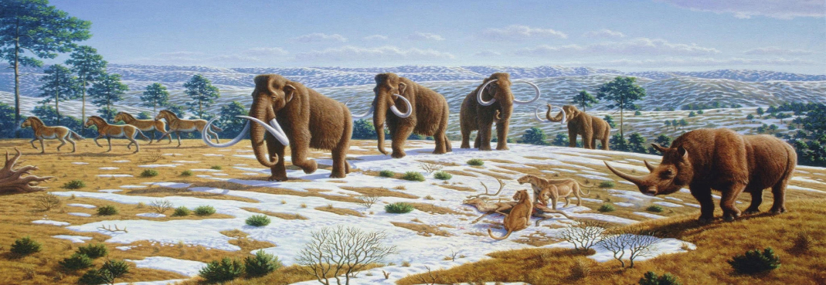
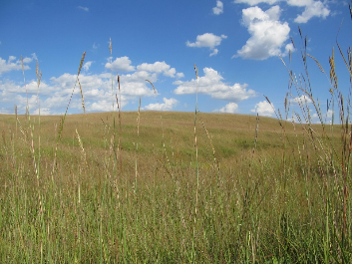
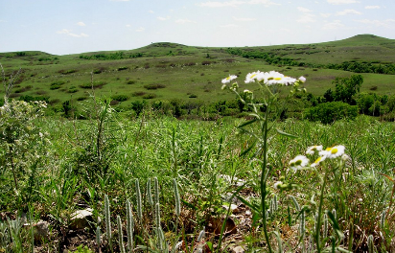
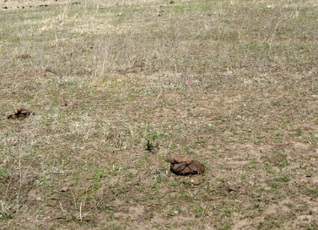
Why care?
Indicators of ecosystem function

Slide 20
What are plants?
Eukaryotic organisms that are:
(Mainly) multicellular
(Mostly) photosynthetic
(Traditionally) in the Kingdom Plantae
Notes:
Caveats and circular reference

Slide 21
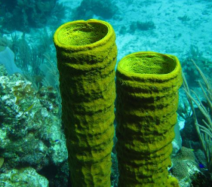
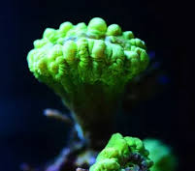
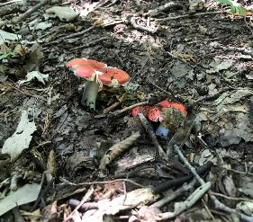
What are plants?

Slide 22
Classification of Life
Taxonomy
Very General
Kingdom
Name, describe, classify
Rank-based system
Linnaeus
Phylum
Latin binomial
Class
Genus species
Order
Family
Genus
Very Specific
Species

Slide 23
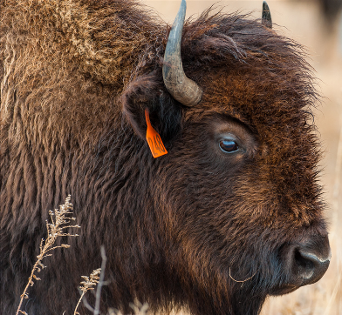
Classification of Life
Animalia
Bison bison
Chordata
Mammalia
Artiodactyla
Bovidae
Bison
bison

Slide 24
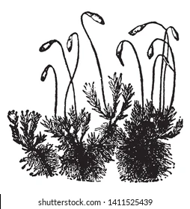
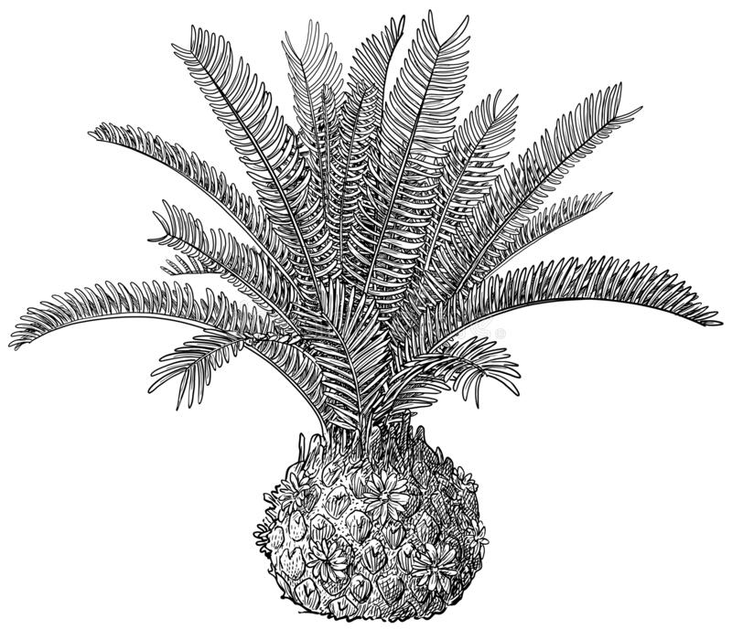
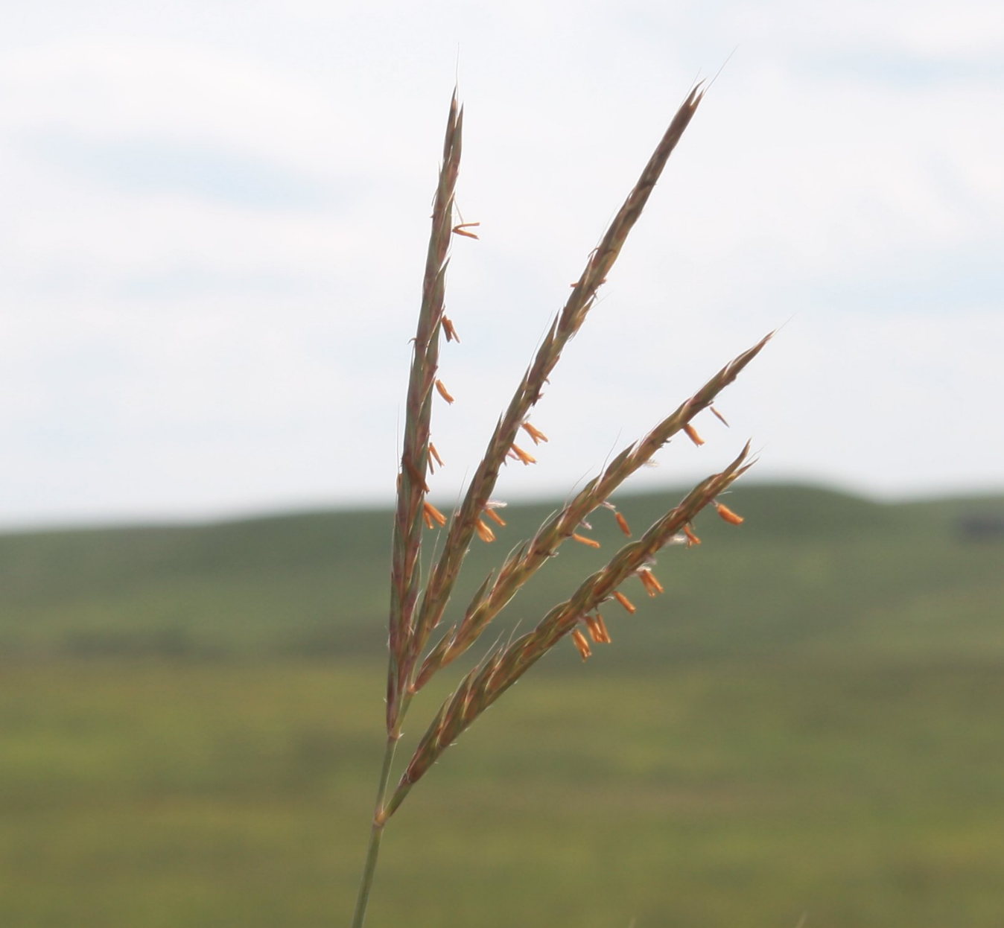
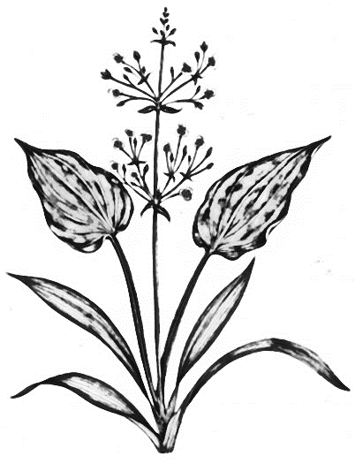
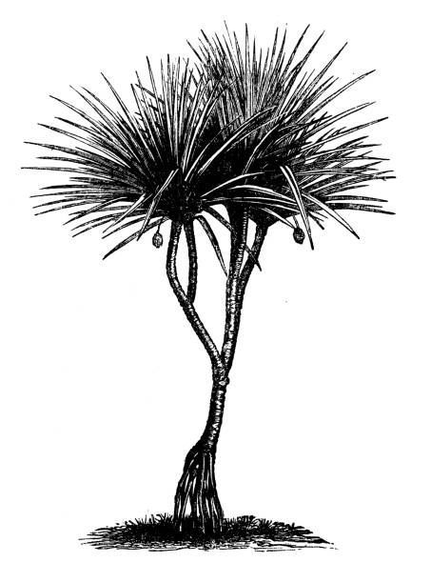
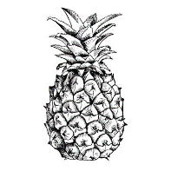
Classification of Life
Plantae
Andropogon gerardii
Magnoliophyta
Liliopsida
Poales
Poacaea
Andropogon
gerardii

Slide 25
Classification of Life
The Six Kingdoms
Prokaryota
Eukaryota
Bacteria
Protista
Plantae
Archaea
Fungi
Animalia
Notes:
Under this system we have 2 domains or realms and six kingdoms.
Eukaryotes have membrane-bound organelles. Fungi with chitin cell walls, plants autotrophic with cellulose, animals mobile with no cell walls, protists are the kitchen junk drawer

Slide 26
What are plants?

Slide 27
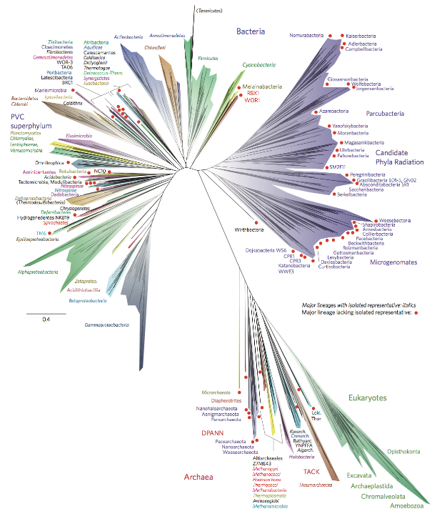
Classification of Life
Systematics
Taxonomy that describes evolutionary relationships (phylogeny)
Latin binomial is retained
Rank-based classification is too simple, breaks down
Hug, Laura A., et al. "A new view of the tree of life." Nature microbiology 1.5 (2016): 1-6.
Notes:
As you can see, this makes it much simpler!

Slide 28
Systematics
Placenta
Live birth
Cladogram
Fur, mammary glands
Amniotic eggs
Notes:
Shows evolutionary relationships and the arrival of certain traits.
Sometimes conflicts with Linnaean groups: 7 vertebrate classes (3 fish classes, Amphibians, reptiles, birds, mammals) All of the tetrapods here are fish.

Slide 29
Classification of Life
Linnaean Classification
Phylogenetic Classification
Simple, plainly organized
Organized but complex
Facilitate
communication
Based on evolutionary relationships
Based on
physical traits
Descriptive, but defies neat hierarchical ranking
Hierarchical system is intuitive but limited

Slide 30
What are plants?
Eukaryotic organisms that are:
(Mainly) multicellular
(Mostly) photosynthetic
(Traditionally) in the Kingdom Plantae
Notes:
Eukaryotes vs. prokaryotes
Endosymbiosis – primary and secondary
Several non-plant groups are multicellular, many others can photosynthesize (algae groups, other protists, fungi, and animals – corals, sponges, sea snails and sloths)

Slide 31
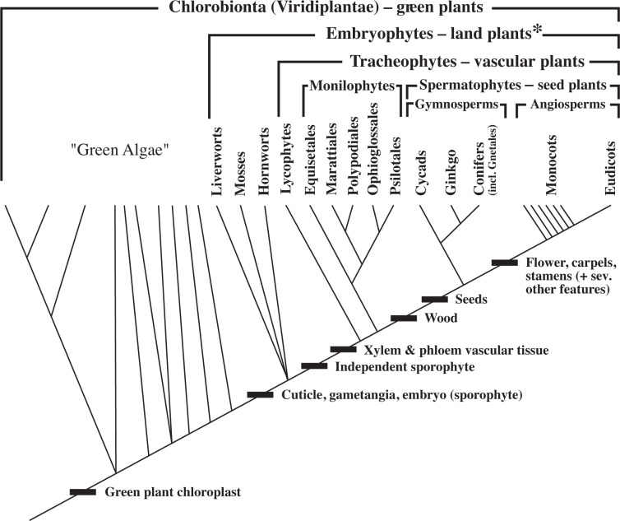
Simpson, Michael G. Plant systematics. Academic press, 2019.
Notes:
Back to exercise 1: where did our plants fit?

Slide 32
What are plants?
A lineage of eukaryotes that photosynthesize using green primary chloroplasts

