Slide 1
Lesson 2
Prairie Food Chains and Food Webs

Slide 2
Food Webs and Energy Pyramids

Slide 3
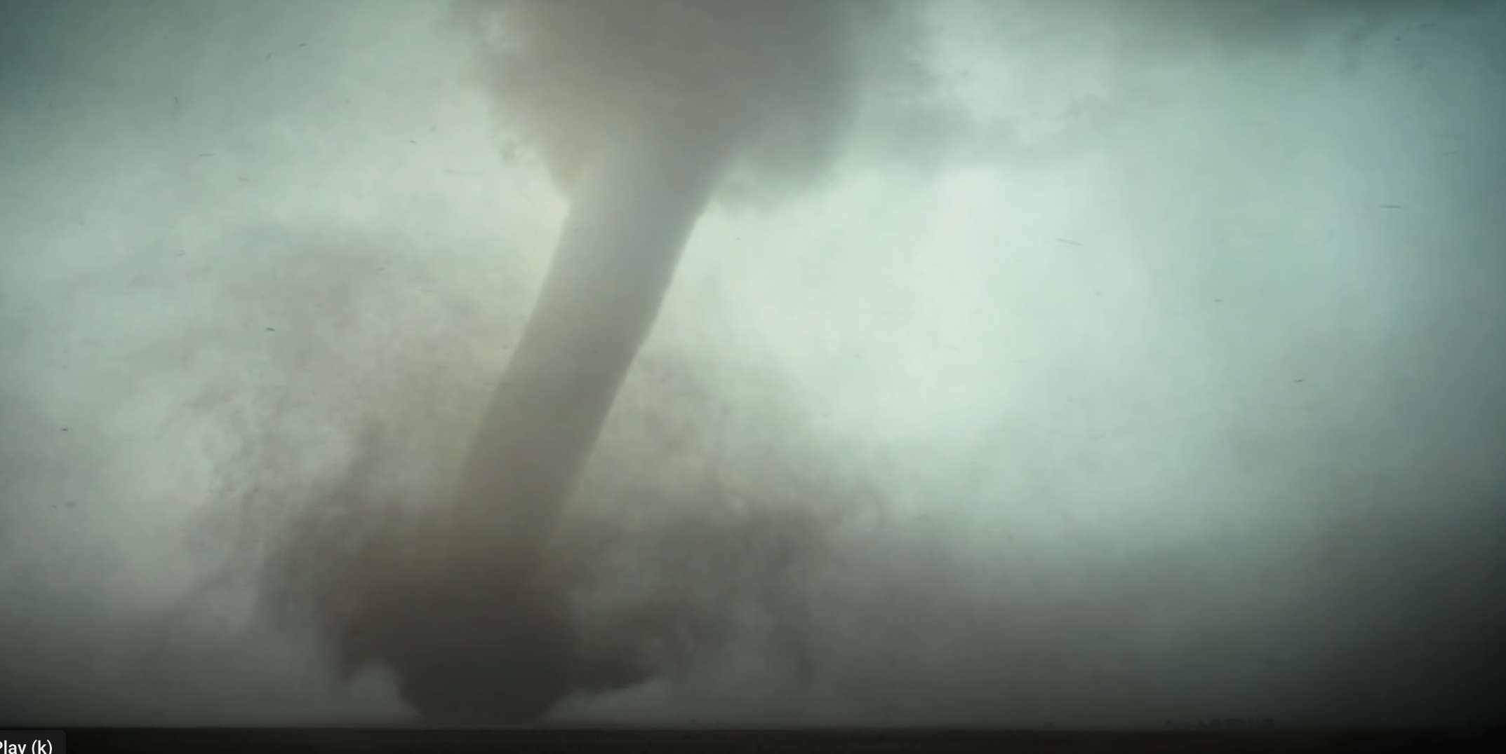
Energy in the atmosphere over the prairie

Slide 4
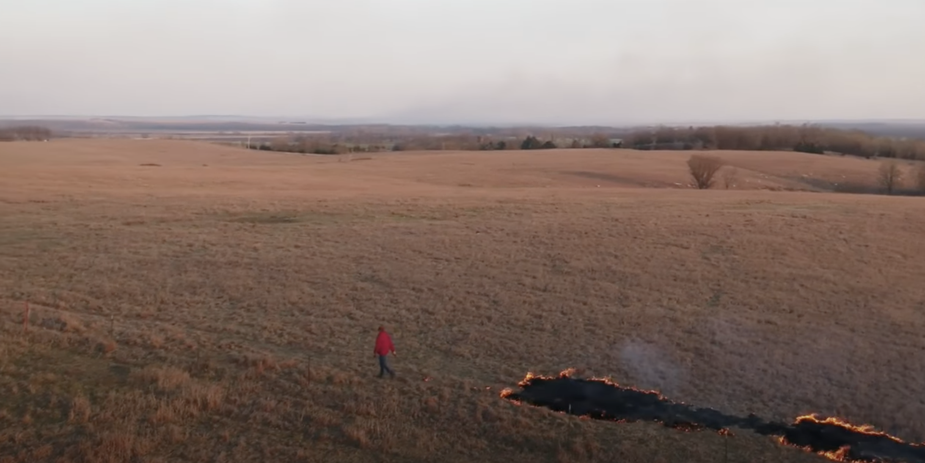

Slide 5
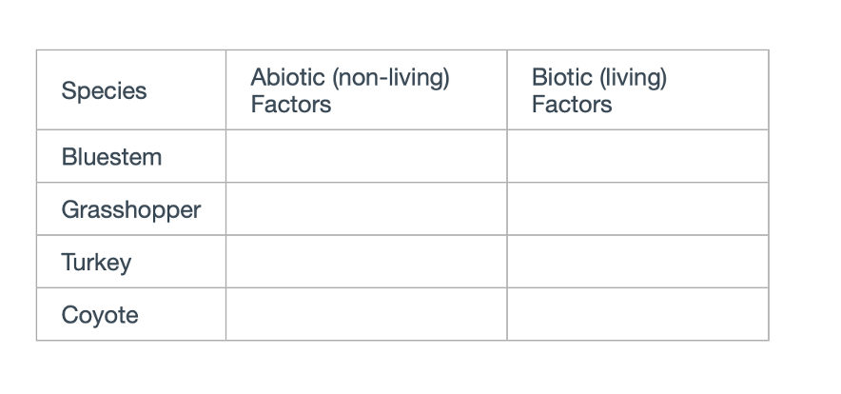

Slide 7
Authors:
Jill Haukos – Konza Environmental Education Program - Konza Prairie Biological Station
Noah Busch - Manhattan-Ogden Public Schools
Robert Hamilton – Linn Mar Community School District, Marion, IA
Jennifer Karr – Manhattan – Ogden Public Schools
Brad Fabrizius – Manhattan-Ogden Public Schools
Benji George – Manhattan-Ogden Public Schools
Brittny England – Riley Counrty School District
Contributors:
Dr. Brian McCornack - Kansas State University
Dr. Zak Ratajczak – Kansas State University
Bess Bookout – Kansas State University
Mary Linabury – Colorado State University

