Slide 1
The Prairie!

Slide 2
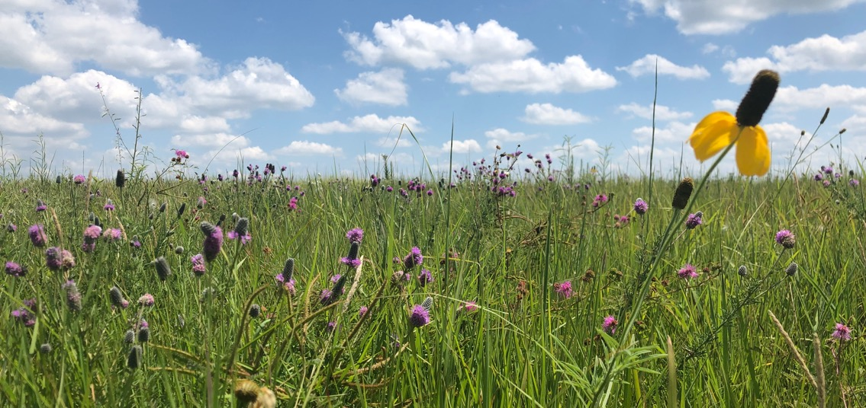
The prairie is found in Kansas
1.
- where YOU live
Have you ever seen prairie?

Slide 3
What do you think a prairie looks like?
2.
Draw a picture of what a prairie looks like to you.
Here’s a video of the tallgrass prairie in the spring
Notes:
Teacher: Please have the students keep their prairie drawings. We will come back to these drawings at the end of the week to see if they want to add anything to them.
Video clip: 40 seconds Students will hear Dickcissels and Bobwhite quail calling. The blooming plant is Wild Alfalfa.

Slide 4
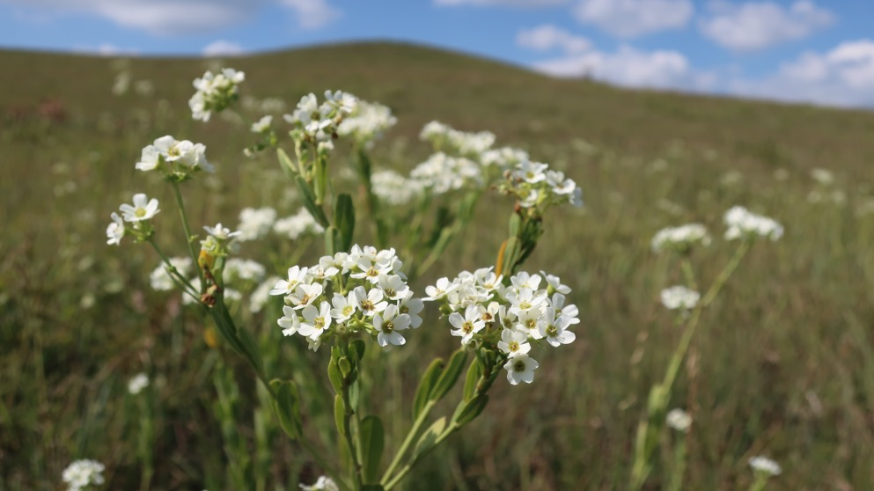
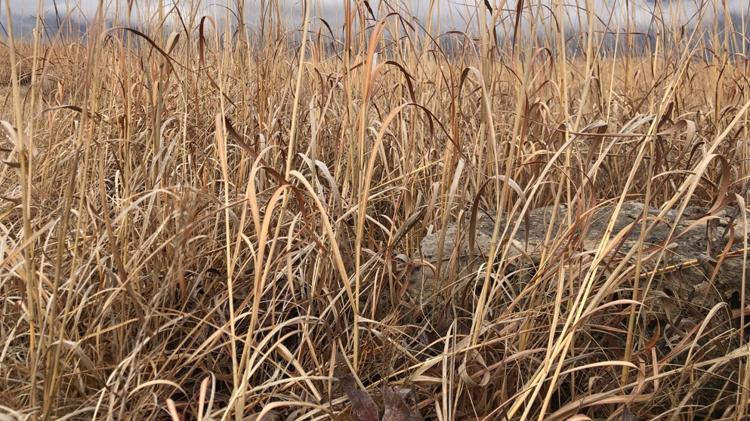
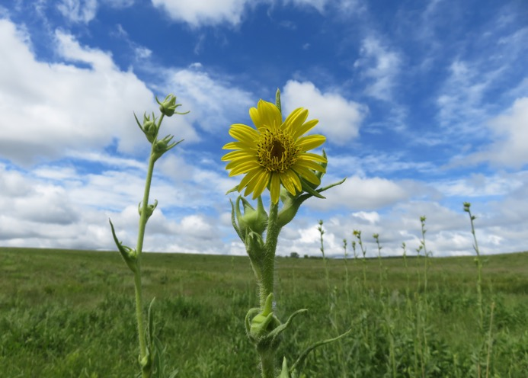
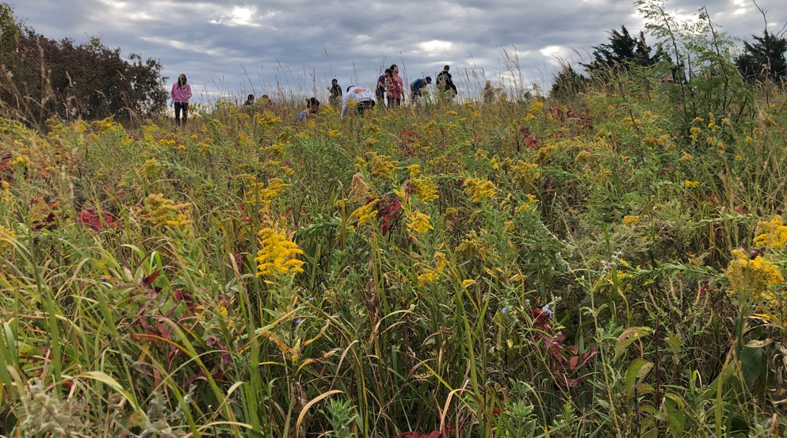
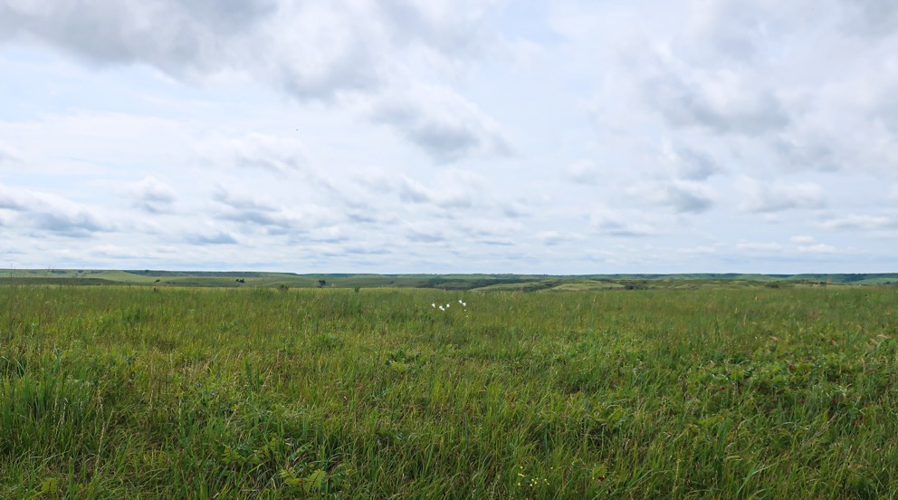
3.

Slide 5
What kinds of plants can we find in a prairie?
4.
In your picture, draw some grasses and some wildflowers
Notes:
ANSWER: the prairie contains mostly grasses and wildflowers. There are some trees, but they are usually in the valleys and next to water, like along a creek.

Slide 6
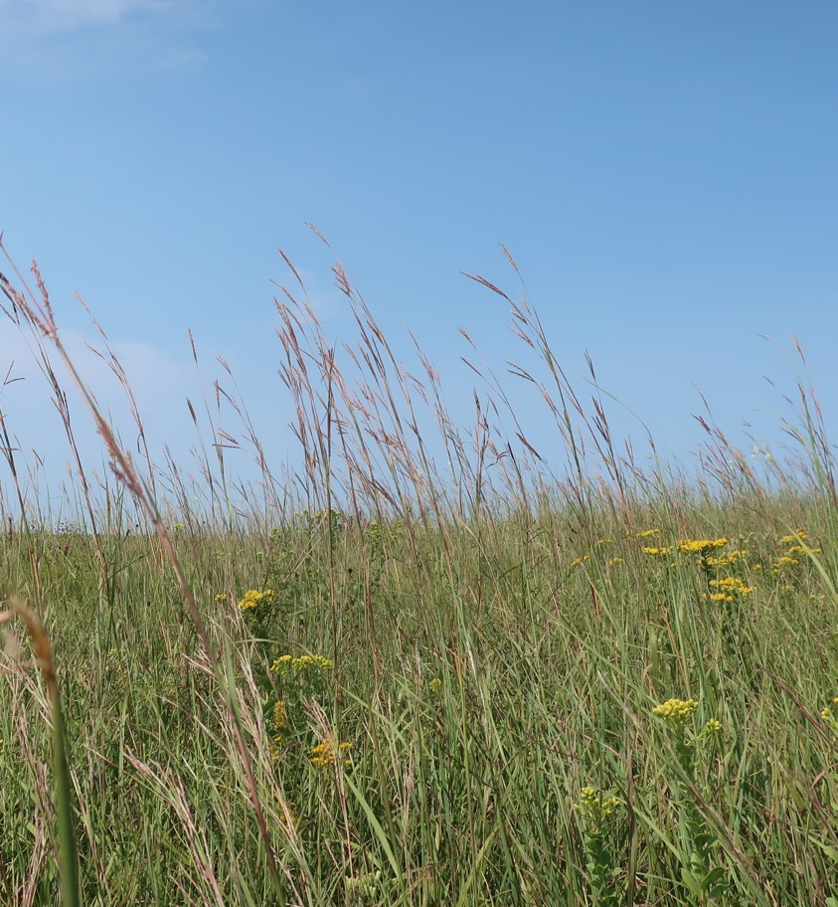
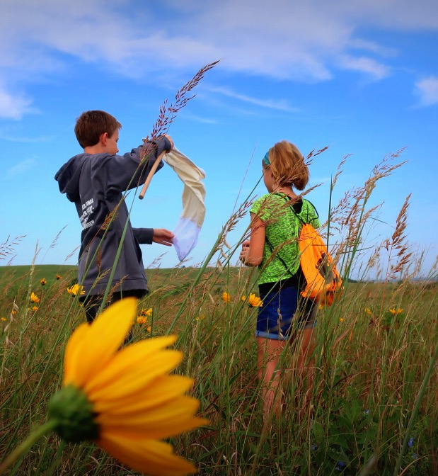
5.

Slide 7
What kinds of animals do we find living on a prairie?
6.
See some of the animals that live on the prairie
Notes:
ANSWER: Many! Lots of butterflies and bees because they love the wildflowers. Lots of lizards and turtles, and lots of birds. Bison are a big part of the prairie.
VIDEO: Will show the bison herd at Konza Prairie. Students will also hear the Dickcissels calling and an Eastern Meadowlark at the end. They will also see grasshoppers flying.

Slide 8
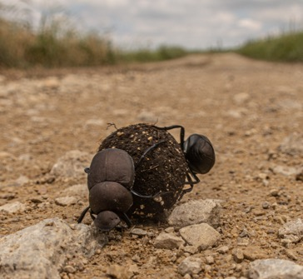
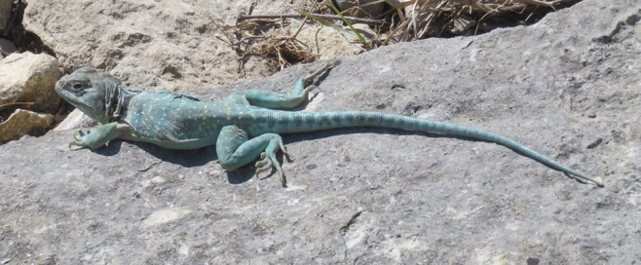
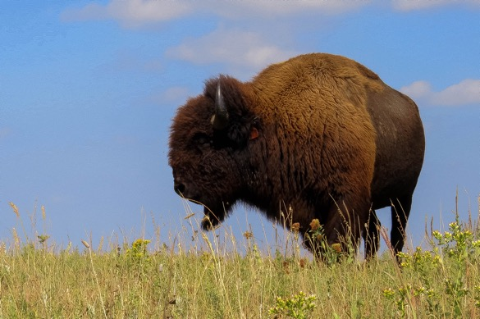
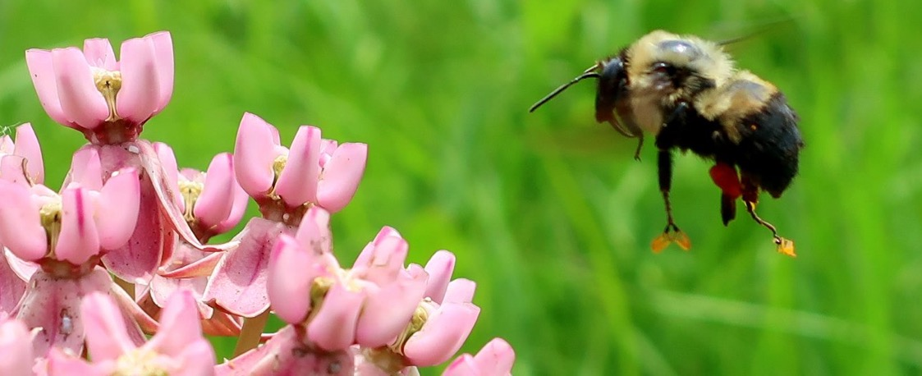
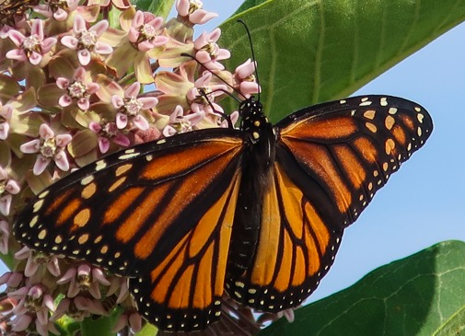
7.
Notes:
Bee – will pollen on his feet
Bison – bull (boy)
Beetles – Dung beetles with a ball of bison dung
Butterfly – Monarch
Lizard – Collared Lizard

Slide 9
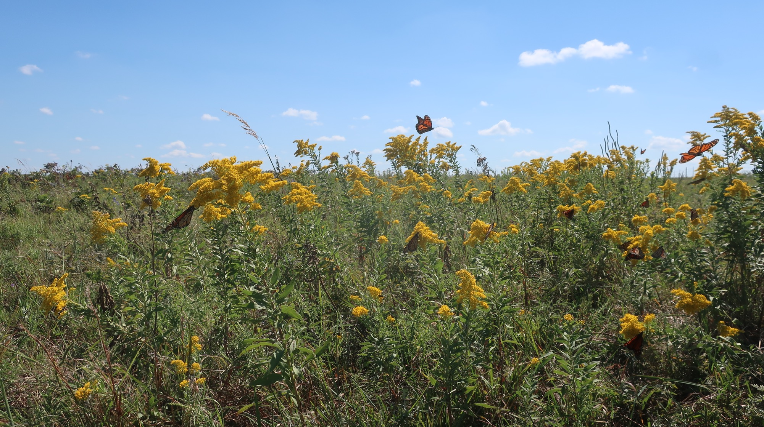
8.
Notes:
Can you see some butterflies on the prairie?
Teacher: These are Monarchs and they stop over at the Konza Prairie Biological Station during their migration south in the winter. The butterflies feed on nectar from the yellow flowers – Goldenrod.

Slide 10
9.
In your picture, draw some butterflies, bees, lizards, turtles, turkeys, hawks, deer, and bison!

Slide 11
10.
Prairies have LOTS of grass and wildflowers.
What kind of plant do we NOT find in a prairie?
It has bark, but it isn’t a dog…
Notes:
ANSWER: Trees. Healthy prairies don’t have many trees. They might be around water, like along a creek or a pond, but otherwise, there isn’t many trees. That’s why pioneer who settled this area didn’t use wood to build their houses, they used rock!

Slide 12
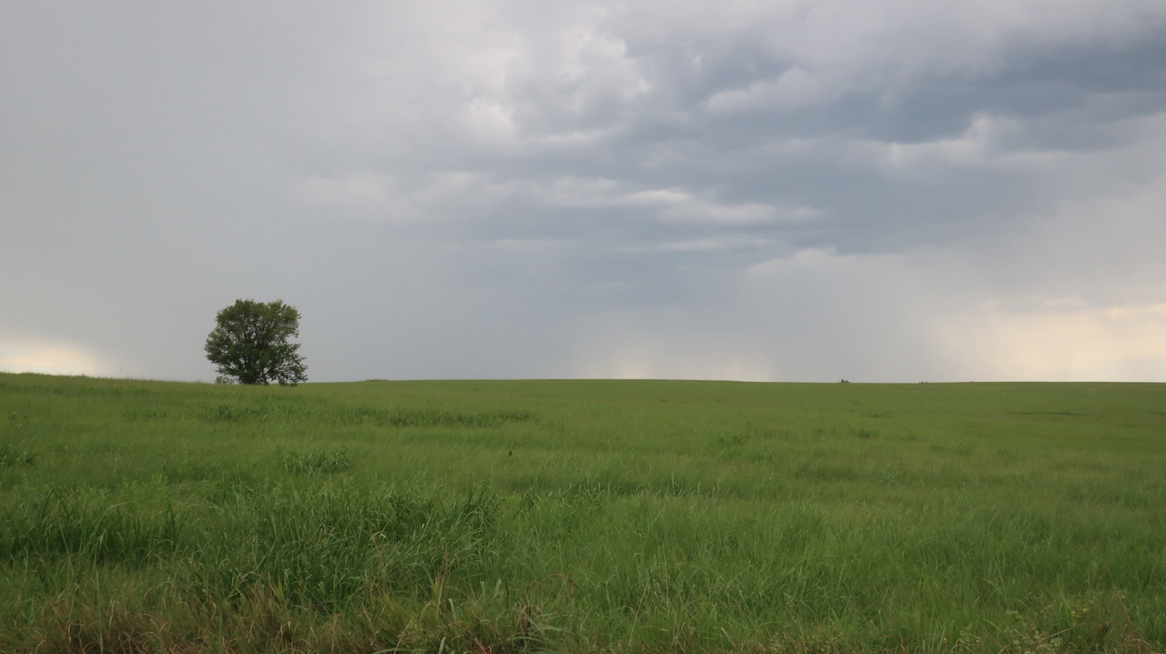
11.
Notes:
This is “lone tree prairie” – a view of a prairie that only has 1 tree. It is probably a very lonely tree. Trees are not normally found on the prairie.

Slide 13
The prairie changes color!
12.
Pictures of the prairie in different seasons
(Winter, Spring, Summer, Fall) :
Notes:
Teacher: Can we guess what season we are looking at in the photos?

Slide 14
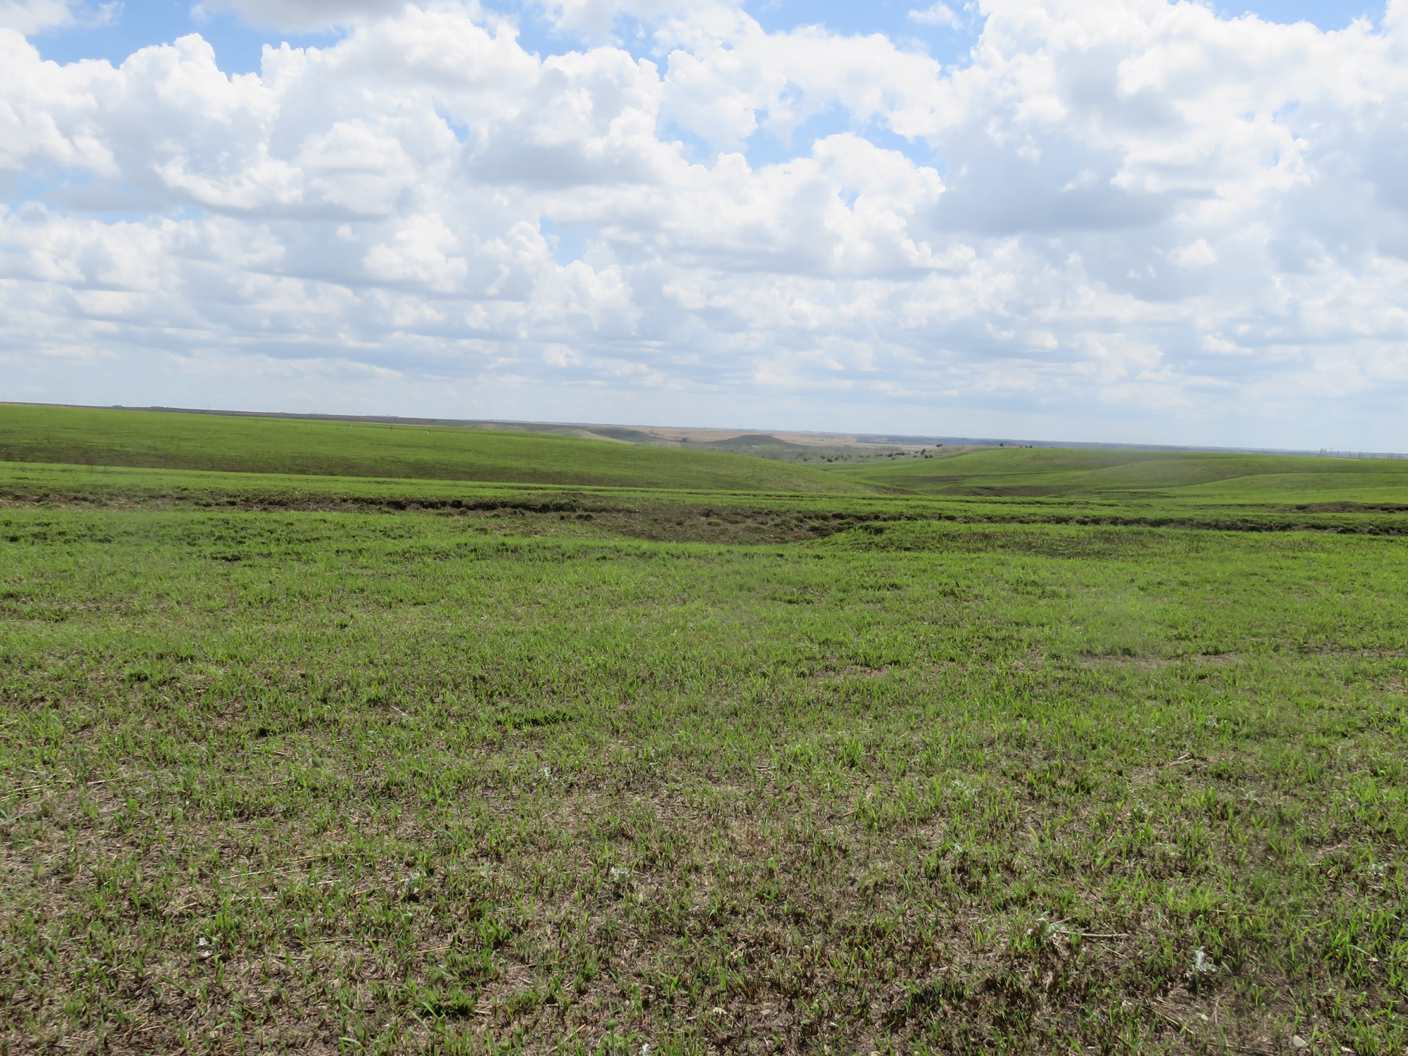
SPRING
13.
Notes:
Teacher: The grass is very short – it begins to grow every spring, but it starts out small.

Slide 15
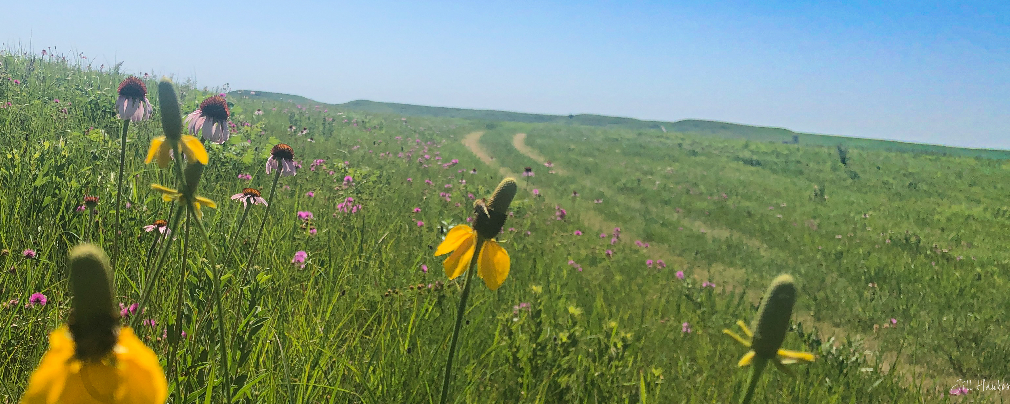
14.
SUMMER
Notes:
Teacher: There are lots of flowers on the prairie in the summer. The grass is getting taller than it was in the spring.

Slide 16
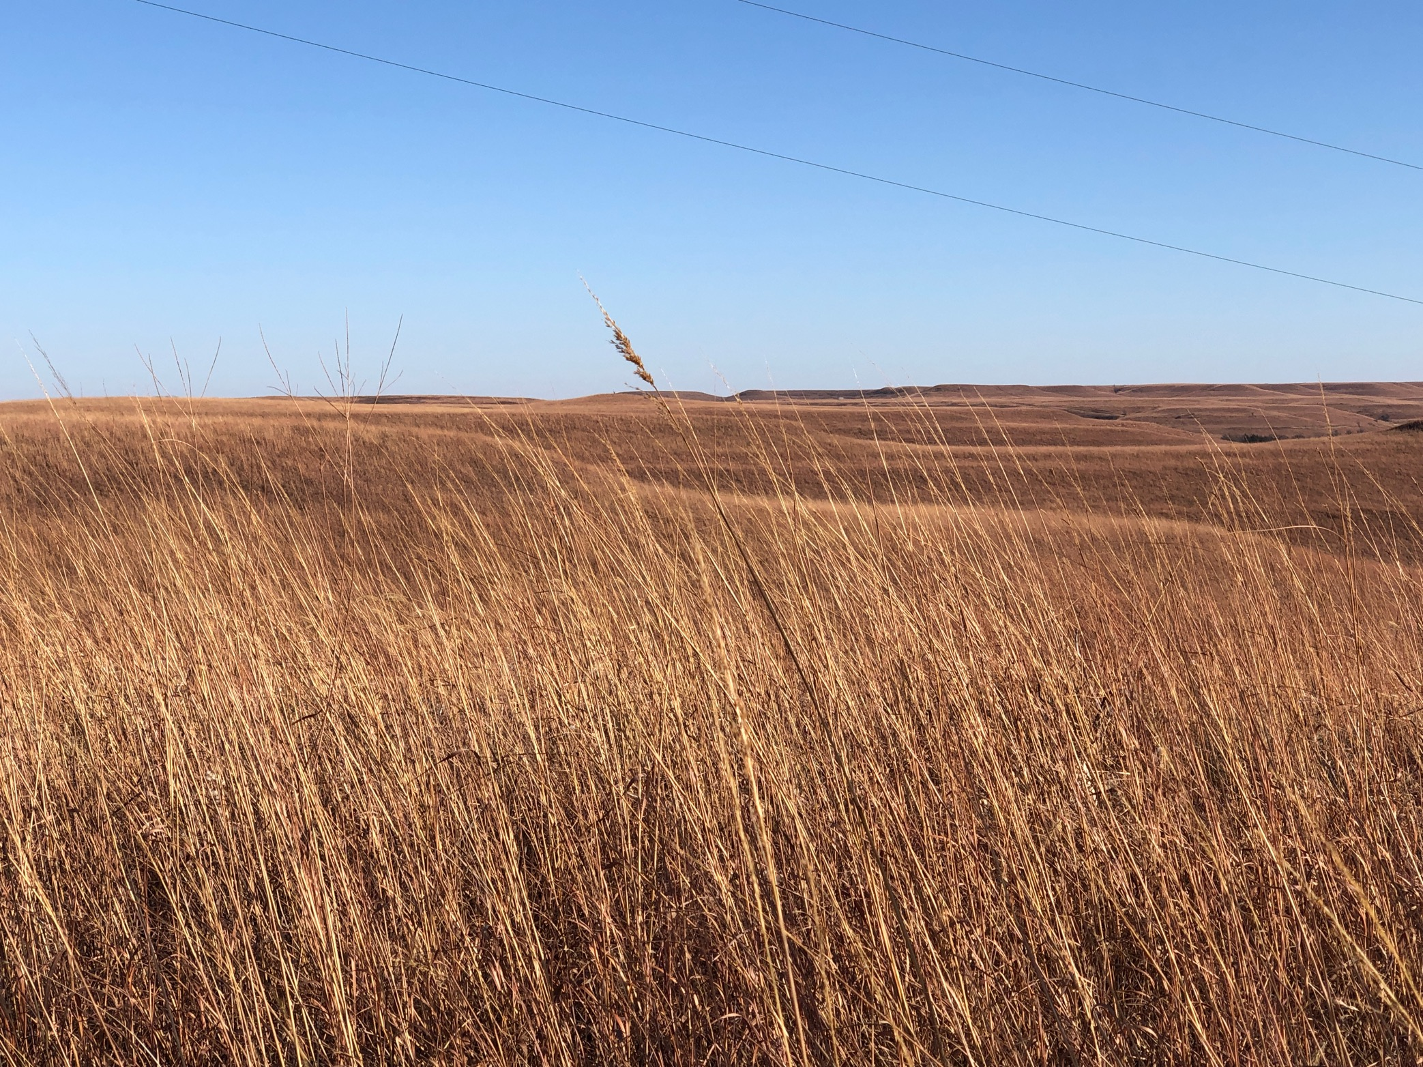
FALL
15.
Notes:
Teacher: The grass is tall, and it isn’t green anymore. After we have a freeze, the grass turns golden yellow. The grass isn’t dead, it is alive underground, but the parts that stick up above the ground aren’t growing anymore.

Slide 17
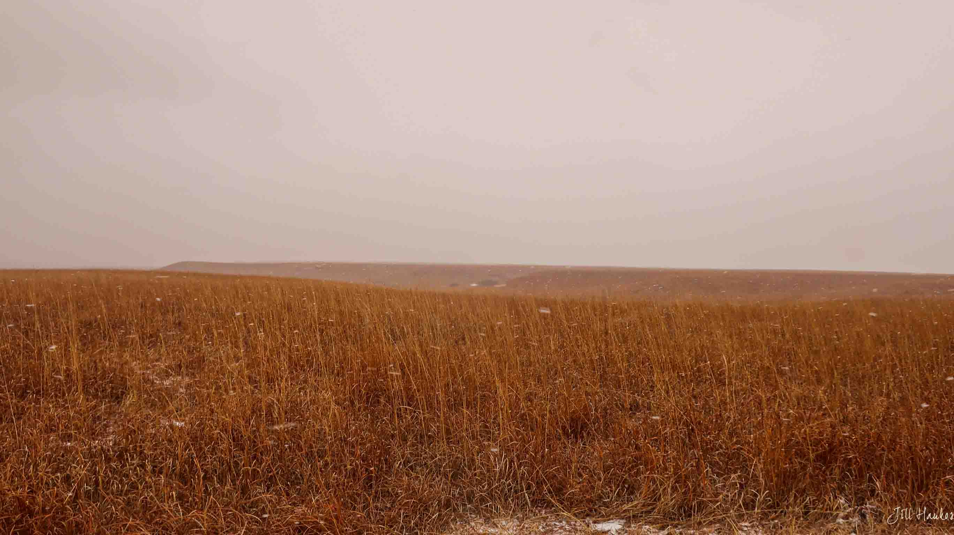
WINTER
16.
Notes:
TEACHER: In the winter the grass turns dark yellow – reddish color. The prairie sleeps during the winter and none of the plants are growing, but they are alive underground!

Slide 18
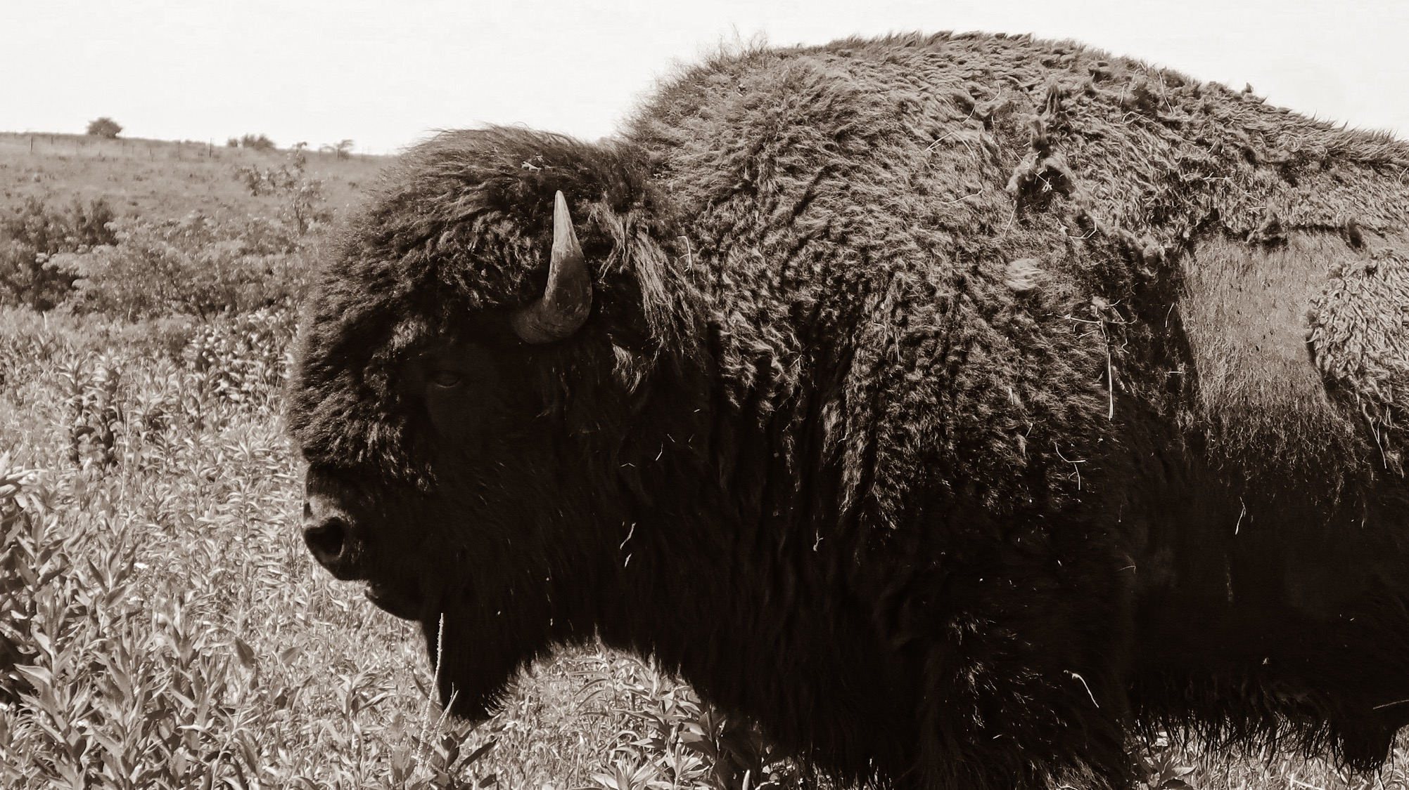
Next – we’ll learn about bison and the prairie!

Slide 19
Author:
Jill Haukos
Konza Environmental Education Program
Konza Prairie Biological Station
Manhattan, KS
© 2023

